Slide 1
Chapter Eighteen
Monopoly
垄断

Slide 2
Structure
What causes monopoly
Profit-maximizing choices of monopoly
Markup pricing
Taxing a monopoly
Inefficiency of monopoly
Natural monopoly (自然垄断)

Slide 3
Pure Monopoly
A monopolized market has a single seller.
The monopolist’s demand curve is the (downward sloping) market demand curve.
So the monopolist can alter the market price by adjusting its output level.

Slide 4
Pure Monopoly
$/output unit
Higher output y causes a
lower market price, p(y).
p(y)
Output Level, y

Slide 5
What causes monopolies?
A legal fiat; e.g. US Postal Service
A patent; e.g. a new drug
Sole ownership of a resource; e.g. a toll highway
Formation of a cartel; e.g. OPEC
Large economies of scale; e.g. local utility companies.

Slide 6
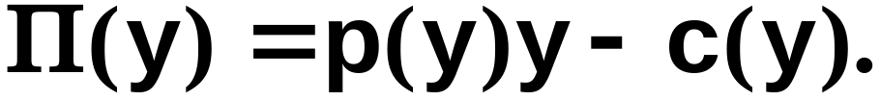
Pure Monopoly
Suppose that the monopolist seeks to maximize its economic profit,
What output level y* maximizes profit?

Slide 7
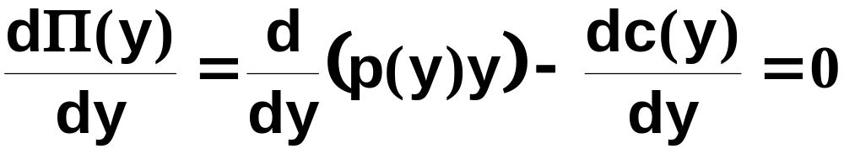
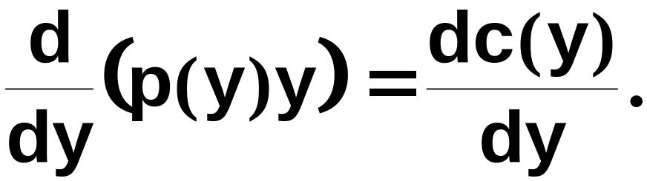
Profit-Maximization
At the profit-maximizing output level y*
so, for y = y*,

Slide 8
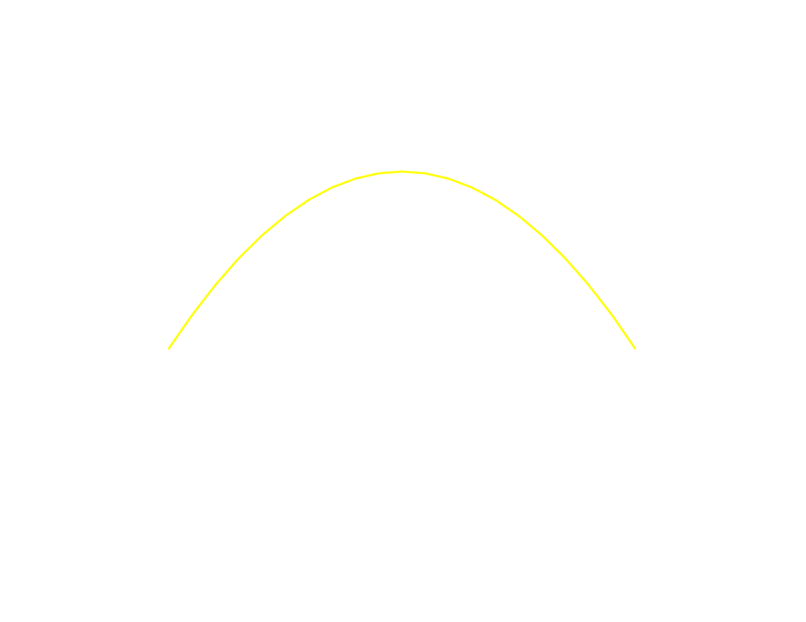
Profit-Maximization
$
R(y) = p(y)y
y

Slide 9
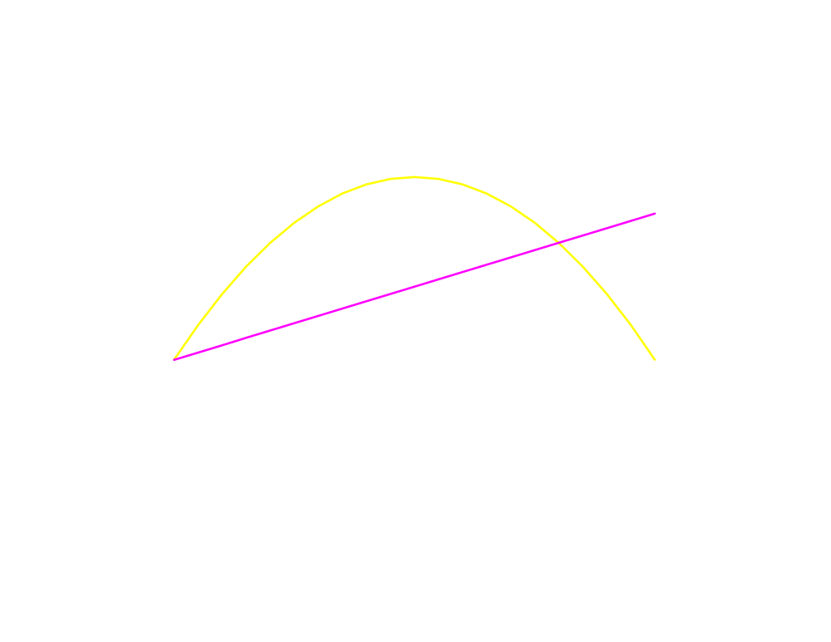
Profit-Maximization
$
R(y) = p(y)y
c(y)
y

Slide 10
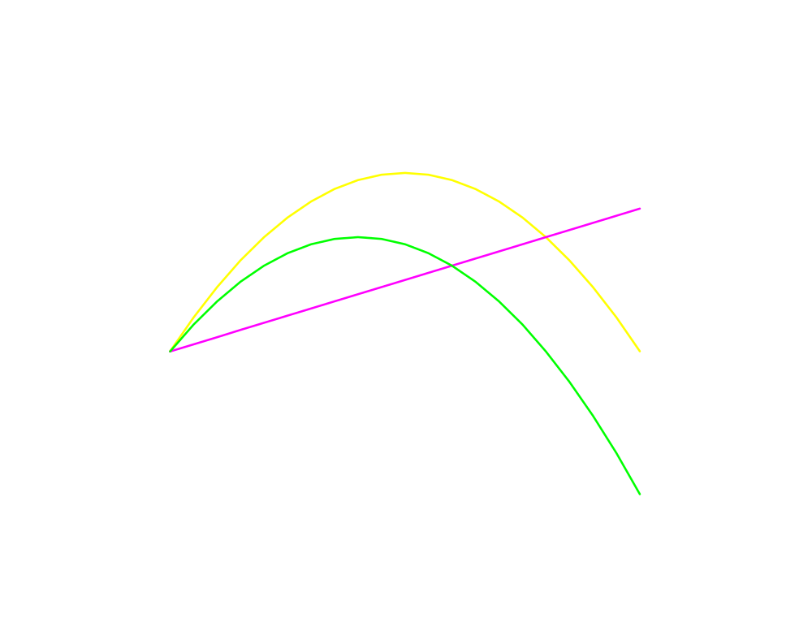
Profit-Maximization
$
R(y) = p(y)y
c(y)
y
Π(y)

Slide 11
Profit-Maximization
$
R(y) = p(y)y
c(y)
y*
y
Π(y)

Slide 12
Profit-Maximization
$
R(y) = p(y)y
c(y)
y*
y
Π(y)

Slide 13
Profit-Maximization
$
R(y) = p(y)y
c(y)
y*
y
Π(y)

Slide 14
Profit-Maximization
$
R(y) = p(y)y
c(y)
y*
y
At the profit-maximizing
output level the slopes of
the revenue and total cost
curves are equal; MR(y*) = MC(y*).
Π(y)

Slide 15
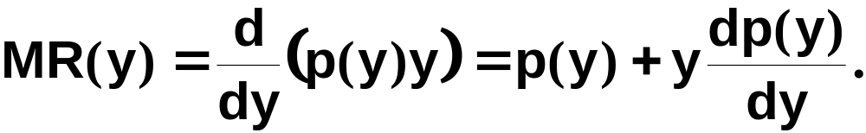
Marginal Revenue
Marginal revenue is the rate-of-change of revenue as the output level y increases;

Slide 16
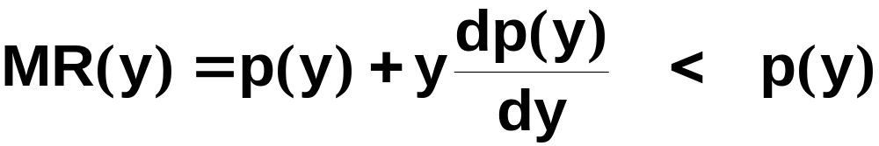
Marginal Revenue
Marginal revenue is the rate-of-change of revenue as the output level y increases;
dp(y)/dy is the slope of the market inverse
demand function so dp(y)/dy < 0. Therefore
for y > 0.

Slide 17
Marginal Revenue
E.g. if p(y) = a - by then
R(y) = p(y)y = ay - by²
and so
MR(y) = a - 2by < a - by = p(y) for y > 0.

Slide 18
Marginal Revenue
E.g. if p(y) = a - by then
R(y) = p(y)y = ay - by²
and so
MR(y) = a - 2by < a - by = p(y) for y > 0.
a
p(y) = a - by
a/2b
a/b
y
MR(y) = a - 2by

Slide 19
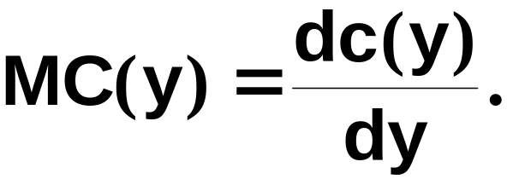

Marginal Cost
Marginal cost is the rate-of-change of total
cost as the output level y increases;
E.g. if c(y) = F + αy + βy² then

Slide 20
Marginal Cost
$
c(y) = F + αy + βy²
F
$/output unit
y
MC(y) = α + 2βy
α
y

Slide 21
Profit-Maximization; An Example
At the profit-maximizing output level y*,
MR(y*) = MC(y*). So if p(y) = a - by and
c(y) = F + αy + βy² then

Slide 22
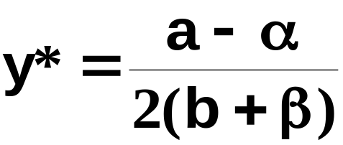
Profit-Maximization; An Example
At the profit-maximizing output level y*,
MR(y*) = MC(y*). So if p(y) = a - by and if
c(y) = F + αy + βy² then
and the profit-maximizing output level is

Slide 23
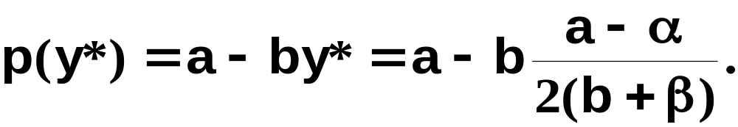
Profit-Maximization; An Example
At the profit-maximizing output level y*,
MR(y*) = MC(y*). So if p(y) = a - by and if
c(y) = F + αy + βy² then
and the profit-maximizing output level is
causing the market price to be

Slide 24
Profit-Maximization; An Example
$/output unit
a
p(y) = a - by
MC(y) = α + 2βy
α
y
MR(y) = a - 2by

Slide 25
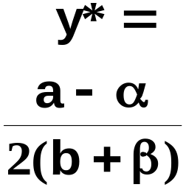
Profit-Maximization; An Example
$/output unit
a
p(y) = a - by
MC(y) = α + 2βy
α
y
MR(y) = a - 2by

Slide 26
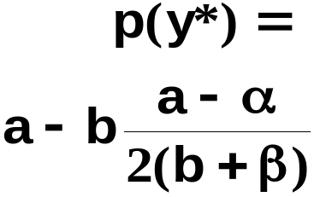
Profit-Maximization; An Example
$/output unit
a
p(y) = a - by
MC(y) = α + 2βy
α
y
MR(y) = a - 2by

Slide 27
Monopolistic Pricing & Own-Price Elasticity of Demand
Suppose that market demand becomes less sensitive to changes in price (i.e. the own-price elasticity of demand becomes less negative). Does the monopolist exploit this by causing the market price to rise?

Slide 28
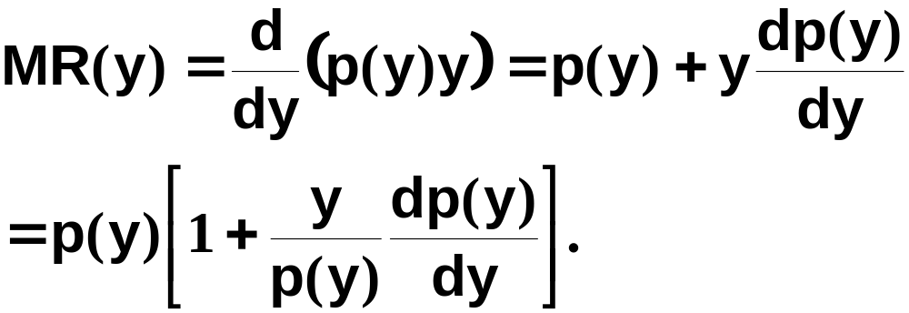
Monopolistic Pricing & Own-Price Elasticity of Demand

Slide 29
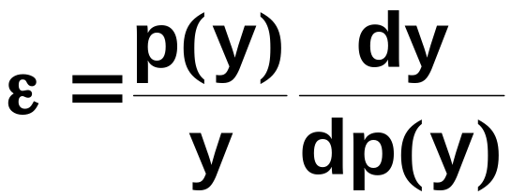
Monopolistic Pricing & Own-Price Elasticity of Demand
Own-price elasticity of demand is

Slide 30
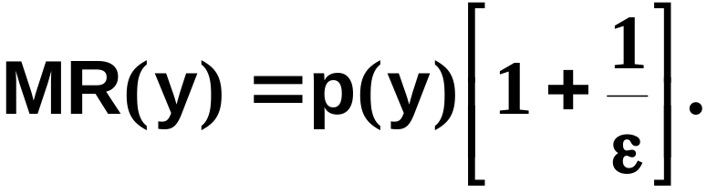
Monopolistic Pricing & Own-Price Elasticity of Demand
Own-price elasticity of demand is
so

Slide 31
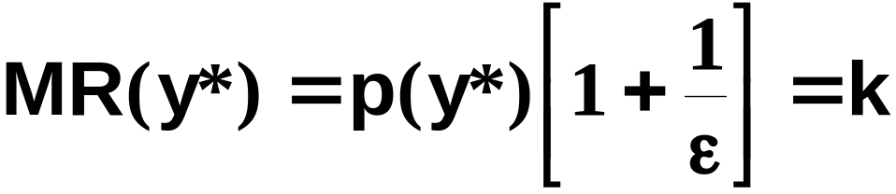
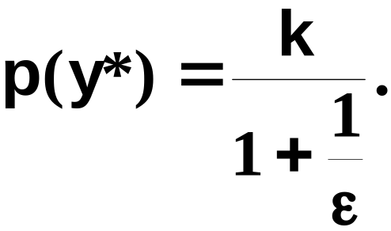
Monopolistic Pricing & Own-Price Elasticity of Demand
Suppose the monopolist’s marginal cost of
production is constant, at $k/output unit.
For a profit-maximum
which is

Slide 32
Monopolistic Pricing & Own-Price Elasticity of Demand
E.g. if ε = -3 then p(y*) = 3k/2,
and if ε = -2 then p(y*) = 2k.
So as ε rises towards -1 the monopolist
alters its output level to make the market
price of its product to rise.

Slide 33
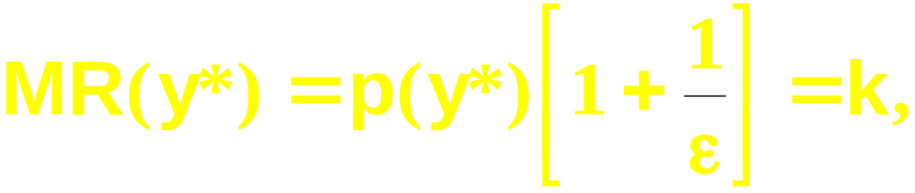
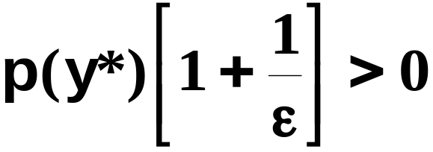
Monopolistic Pricing & Own-Price Elasticity of Demand
Notice that, since

Slide 34
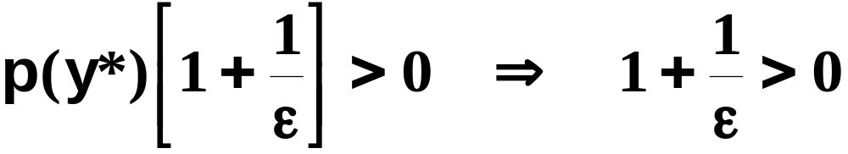
Monopolistic Pricing & Own-Price Elasticity of Demand
Notice that, since

Slide 35
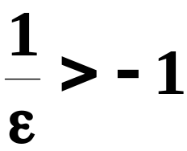
Monopolistic Pricing & Own-Price Elasticity of Demand
Notice that, since
That is,

Slide 36
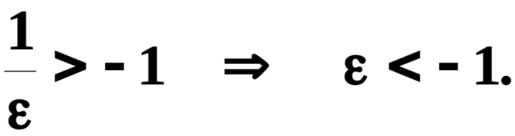
Monopolistic Pricing & Own-Price Elasticity of Demand
Notice that, since
That is,

Slide 37
Monopolistic Pricing & Own-Price Elasticity of Demand
Notice that, since
That is,
So a profit-maximizing monopolist always
selects an output level for which market
demand is own-price elastic.

Slide 38
Markup Pricing
Markup pricing: Output price is the marginal cost of production plus a “markup.”
How big is a monopolist’s markup and how does it change with the own-price elasticity of demand?

Slide 39
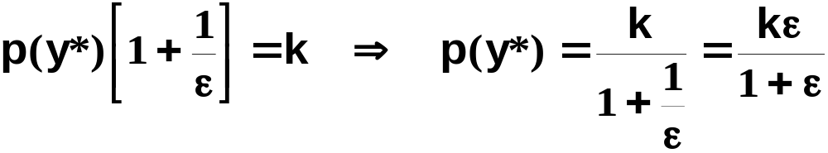
Markup Pricing
is the monopolist’s price.

Slide 40
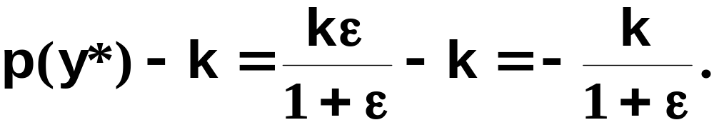
Markup Pricing
is the monopolist’s price. The markup is

Slide 41
Markup Pricing
is the monopolist’s price. The markup is
E.g. if ε = -3 then the markup is k/2,
and if ε = -2 then the markup is k.
The markup rises as the own-price
elasticity of demand rises towards -1.

Slide 42
A Profits Tax Levied on a Monopoly
A profits tax levied at rate t reduces profit from Π(y*) to (1-t)Π(y*).
Q: How is after-tax profit, (1-t)Π(y*), maximized?
A: By maximizing before-tax profit, Π(y*).
So a profits tax has no effect on the monopolist’s choices of output level, output price, or demands for inputs.
I.e. the profits tax is a neutral tax.

Slide 43
Quantity Tax Levied on a Monopolist
A quantity tax of $t/output unit raises the marginal cost of production by $t.
So the tax reduces the profit-maximizing output level, causes the market price to rise, and input demands to fall.
The quantity tax is distortionary（扭曲）.

Slide 44
Linear Demand Curve
$/output unit
p(y)
p(y*)
MC(y)
y*
y
MR(y)

Slide 45
Linear Demand Curve
$/output unit
p(y)
MC(y) + t
p(y*)
t
MC(y)
y*
y
MR(y)

Slide 46
Linear Demand Curve
$/output unit
p(y)
p(y^{t})
MC(y) + t
p(y*)
t
MC(y)
y^{t}
y*
y
MR(y)

Slide 47
Linear Demand Curve
The quantity tax causes a drop
in the output level, a rise in the
output’s price and a decline in
demand for inputs.
$/output unit
p(y)
p(y^{t})
MC(y) + t
p(y*)
t
MC(y)
y^{t}
y*
y
MR(y)

Slide 48
Linear Demand Curve
p=a-by
MR=a-2by
With tax, MC=c+t
Profit maximization: a-2by=c+t
y=(a-c-t)/2b
p(y)=a-by=a-(a-c-t)/2
dp/dt=1/2
The monopolist passes on half of the tax.

Slide 49
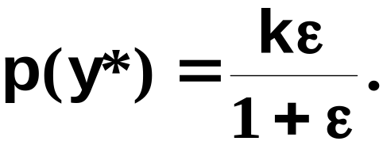
Constant Elasticity Demand
Can a monopolist “pass” all of a $t quantity tax to the consumers?
Suppose the marginal cost of production is constant at $k/output unit.
With no tax, the monopolist’s price is

Slide 50
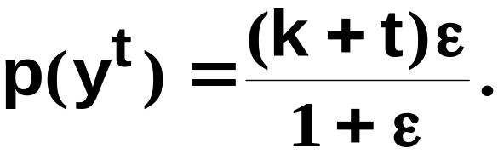
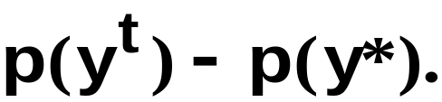
Constant Elasticity Demand
The tax increases marginal cost to $(k+t)/output unit, changing the profit-maximizing price to
The amount of the tax paid by buyers is

Slide 51
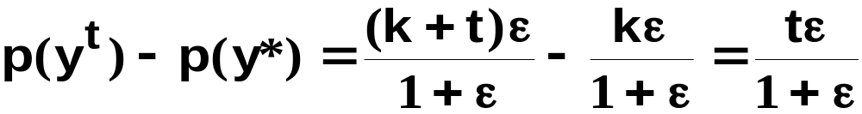
Constant Elasticity Demand
is the amount of the tax passed on to
buyers. E.g. if ε = -2, the amount of
the tax passed on is 2t.
Because ε < -1, ε /(1+ε) > 1 and so the
monopolist passes on to consumers more
than the tax!

Slide 52
The Inefficiency of Monopoly
A market is Pareto efficient if it achieves the maximum possible total gains-to-trade.
Otherwise a market is Pareto inefficient.

Slide 53
The Inefficiency of Monopoly
$/output unit
The efficient output level
y^{e} satisfies p(y) = MC(y).
p(y)
MC(y)
p(y^{e})
y^{e}
y

Slide 54
The Inefficiency of Monopoly
$/output unit
The efficient output level
y^{e} satisfies p(y) = MC(y).
p(y)
CS
MC(y)
p(y^{e})
y^{e}
y

Slide 55
The Inefficiency of Monopoly
$/output unit
The efficient output level
y^{e} satisfies p(y) = MC(y).
p(y)
CS
MC(y)
p(y^{e})
PS
y^{e}
y

Slide 56
The Inefficiency of Monopoly
$/output unit
The efficient output level
y^{e} satisfies p(y) = MC(y).
Total gains-to-trade is
maximized.
p(y)
CS
MC(y)
p(y^{e})
PS
y^{e}
y

Slide 57
The Inefficiency of Monopoly
$/output unit
p(y)
p(y*)
MC(y)
y*
y
MR(y)

Slide 58
The Inefficiency of Monopoly
$/output unit
p(y)
CS
p(y*)
MC(y)
y*
y
MR(y)

Slide 59
The Inefficiency of Monopoly
$/output unit
p(y)
CS
p(y*)
PS
MC(y)
y*
y
MR(y)

Slide 60
The Inefficiency of Monopoly
$/output unit
p(y)
CS
p(y*)
PS
MC(y)
y*
y
MR(y)

Slide 61
The Inefficiency of Monopoly
$/output unit
p(y)
CS
p(y*)
PS
MC(y)
y*
y
MR(y)

Slide 62
The Inefficiency of Monopoly
$/output unit
MC(y*+1) < p(y*+1) so both
seller and buyer could gain
if the (y*+1)th unit of output
was produced. Hence the
market
is Pareto inefficient.
p(y)
CS
p(y*)
PS
MC(y)
y*
y
MR(y)

Slide 63
The Inefficiency of Monopoly
$/output unit
Deadweight loss measures
the gains-to-trade not
achieved by the market.
p(y)
p(y*)
MC(y)
DWL
y*
y
MR(y)

Slide 64
The Inefficiency of Monopoly
The monopolist produces less than the efficient quantity, making the market price exceed the
efficient market
price.
$/output unit
p(y)
p(y*)
MC(y)
p(y^{e})
DWL
y*
y^{e}
y
MR(y)

Slide 65
Natural Monopoly
A natural monopoly arises when the firm’s technology has economies-of-scale （规模经济）large enough for it to supply the whole market at a lower average total production cost than is possible with more than one firm in the market.

Slide 66
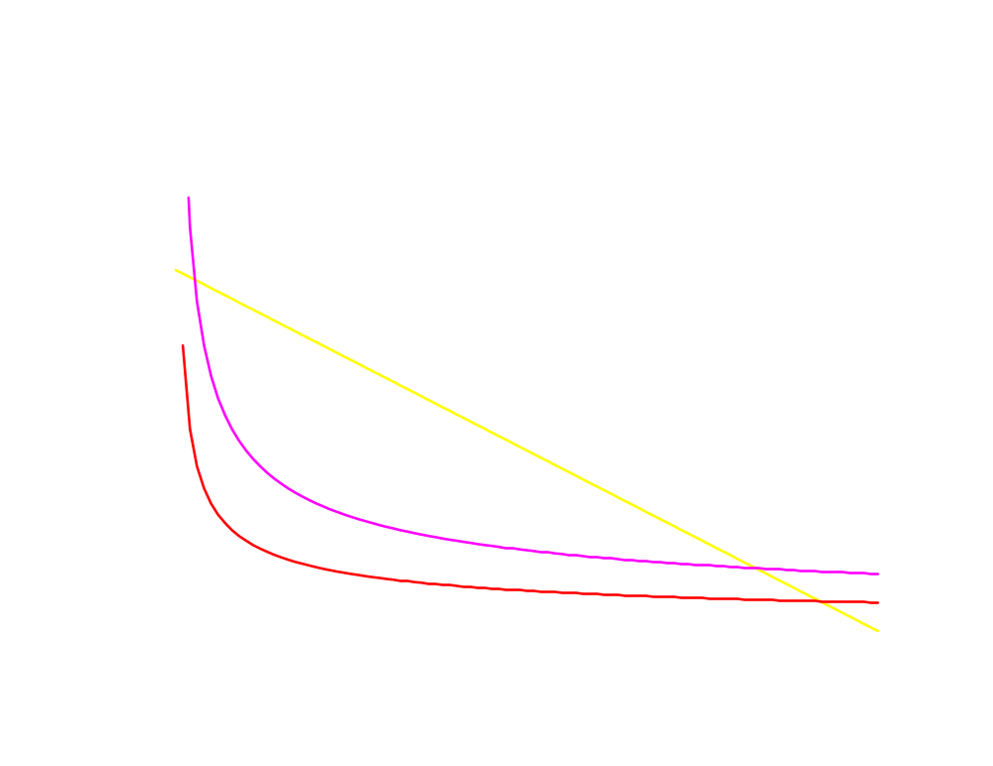
Natural Monopoly
$/output unit
ATC(y)
p(y)
MC(y)
y

Slide 67
Natural Monopoly
$/output unit
ATC(y)
p(y)
p(y*)
MC(y)
y*
y
MR(y)

Slide 68
Entry Deterrence by a Natural Monopoly
A natural monopoly deters entry by threatening predatory pricing （掠夺性定价）against an entrant.
A predatory price is a low price set by the incumbent firm when an entrant appears, causing the entrant’s economic profits to be negative and inducing its exit.

Slide 69
Inefficiency of a Natural Monopolist
Like any profit-maximizing monopolist, the natural monopolist causes a deadweight loss.

Slide 70
Inefficiency of a Natural Monopoly
$/output unit
ATC(y)
p(y)
p(y*)
MC(y)
y*
y
MR(y)

Slide 71
Inefficiency of a Natural Monopoly
$/output unit
ATC(y)
Profit-max: MR(y) = MC(y)
Efficiency: p = MC(y)
p(y)
p(y*)
MC(y)
p(y^{e})
y*
y^{e}
y
MR(y)

Slide 72
Inefficiency of a Natural Monopoly
$/output unit
ATC(y)
Profit-max: MR(y) = MC(y)
Efficiency: p = MC(y)
p(y)
p(y*)
DWL
MC(y)
p(y^{e})
y*
y^{e}
y
MR(y)

Slide 73
Regulating a Natural Monopoly
Why not command that a natural monopoly produce the efficient amount of output?
Then the deadweight loss will be zero, won’t it?

Slide 74
Regulating a Natural Monopoly
$/output unit
At the efficient output
level y^{e}, ATC(y^{e}) > p(y^{e})
ATC(y)
p(y)
MC(y)
ATC(y^{e})
p(y^{e})
y^{e}
y
MR(y)

Slide 75
Regulating a Natural Monopoly
$/output unit
At the efficient output
level y^{e}, ATC(y^{e}) > p(y^{e})
so the firm makes an
economic loss.
ATC(y)
p(y)
MC(y)
ATC(y^{e})
Economic loss
p(y^{e})
y^{e}
y
MR(y)

Slide 76
Regulating a Natural Monopoly
So a natural monopoly cannot be forced to use marginal cost pricing. Doing so makes the firm exit, destroying both the market and any gains-to-trade.
Regulatory schemes can induce the natural monopolist to produce the efficient output level without exiting.

Slide 77
Regulating a Natural Monopoly
Average cost pricing
  2nd best solution
  Difficulty: How to measure costs?
Government-ownership

Slide 78
Average Cost Pricing
$/output unit
ATC(y)
p(y)
MC(y)
P_{AC}
y_{AC}
y
MR(y)

Slide 79
What Causes Monopolies
Underlying technology
  Minimum efficient scale
Market size
Collusion

Slide 80
What Causes Monopolies
p
Demand
AC
p∗
MES
y

Slide 81
What Causes Monopolies
AC
p∗
Demand
MES
y

